Slide 1
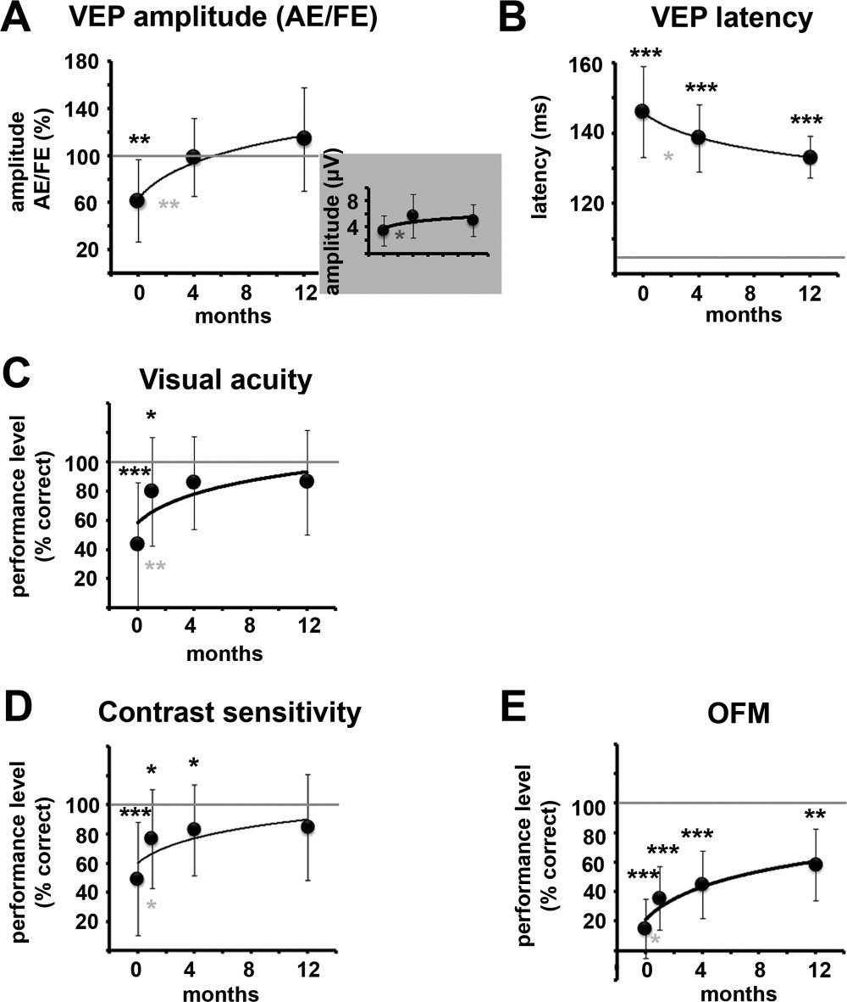
Demyelination affects temporal aspects of perception: An optic neuritis study
Annals of Neurology, Volume: 71, Issue: 4, Pages: 531-538, First published: 09 December 2011, DOI: (10.1002/ana.22692)
Notes:
Visual evoked potential (VEP) measurements, and static and dynamic visual functions throughout the 12‐month follow‐up. Changes in VEP amplitudes (A) and VEP latencies (B) over time are shown. VEP amplitudes from the affected eyes (AEs) are expressed as a percentage of those of the fellow eyes (FEs). Inset denotes absolute amplitude levels for the AEs. Changes in static (C,D) and dynamic (E) visual functions (motion perception assessed by the object from motion [OFM] test) are plotted over time. To obtain a direct comparison between measures, performance levels are expressed as a percentage of the normal values in each measure (100% of visual acuity equals 1 decimal; 100% of contrast sensitivity equals logMAR = 1.84; 100% of OFM equals control subjects' mean in each phase). Gray horizontal lines mark the mean normal values. There were 21, 20, 18, and 14 subjects in the acute, 1‐, 4‐, and 12‐month time points, respectively. Black asterisks denote significant reduction of AE performance compared to the normal values. Gray asterisks denote significant change in the AE measurements between testing phases. *p < 0.05; **p < 0.01; ***p < 0.001.
IF THIS IMAGE HAS BEEN PROVIDED BY OR IS OWNED BY A THIRD PARTY, AS INDICATED IN THE CAPTION LINE, THEN FURTHER PERMISSION MAY BE NEEDED BEFORE ANY FURTHER USE. PLEASE CONTACT WILEY'S PERMISSIONS DEPARTMENT ON PERMISSIONS@WILEY.COM OR USE THE RIGHTSLINK SERVICE BY CLICKING ON THE 'REQUEST PERMISSIONS' LINK ACCOMPANYING THIS ARTICLE. WILEY OR AUTHOR OWNED IMAGES MAY BE USED FOR NON-COMMERCIAL PURPOSES, SUBJECT TO PROPER CITATION OF THE ARTICLE, AUTHOR, AND PUBLISHER.

